Slide 1
GAD Planning
and Budgeting
PHALGA 17th Mindanao Geographical Conference
Zamboanga City I February 26, 2025
Kim Harold T. Peji
Officer-in-Charge
Philippine Commission on Women - Technical Services
and Regional Coordination Division

Slide 2

The PCW is a policymaking, advisory, and coordinating body that leads in the development of gender-responsive policies, conduct of advocacy, provision of appropriate and strategic technical assistance, and monitoring and evaluation of plans and programs on gender mainstreaming towards a more gender responsive government bureaucracy and institutions.

Slide 3

Have you attended a learning session
on GAD Planning and Budgeting?
Yes
No

Slide 4

OBJECTIVES
1
Orient the participants on the policy imperatives on local GAD Planning and Budgeting
Discuss the essential elements and guide on local GAD Planning and Budgeting
2

Slide 5
DISCUSSION FLOW
WHY
WHAT
HOW
Need for GAD Planning and Budgeting
Policy Imperatives in GAD Planning and Budgeting
Step-by-Step Guide in Preparing the GAD PB and GAD AR

Slide 6
GENERAL GUIDELINES

Slide 7
DISCUSSION FLOW
WHY
WHAT
HOW
Need for GAD Planning and Budgeting
Policy Imperatives in GAD Planning and Budgeting
Step-by-Step Guide in Preparing the GAD PB and GAD AR

Slide 8
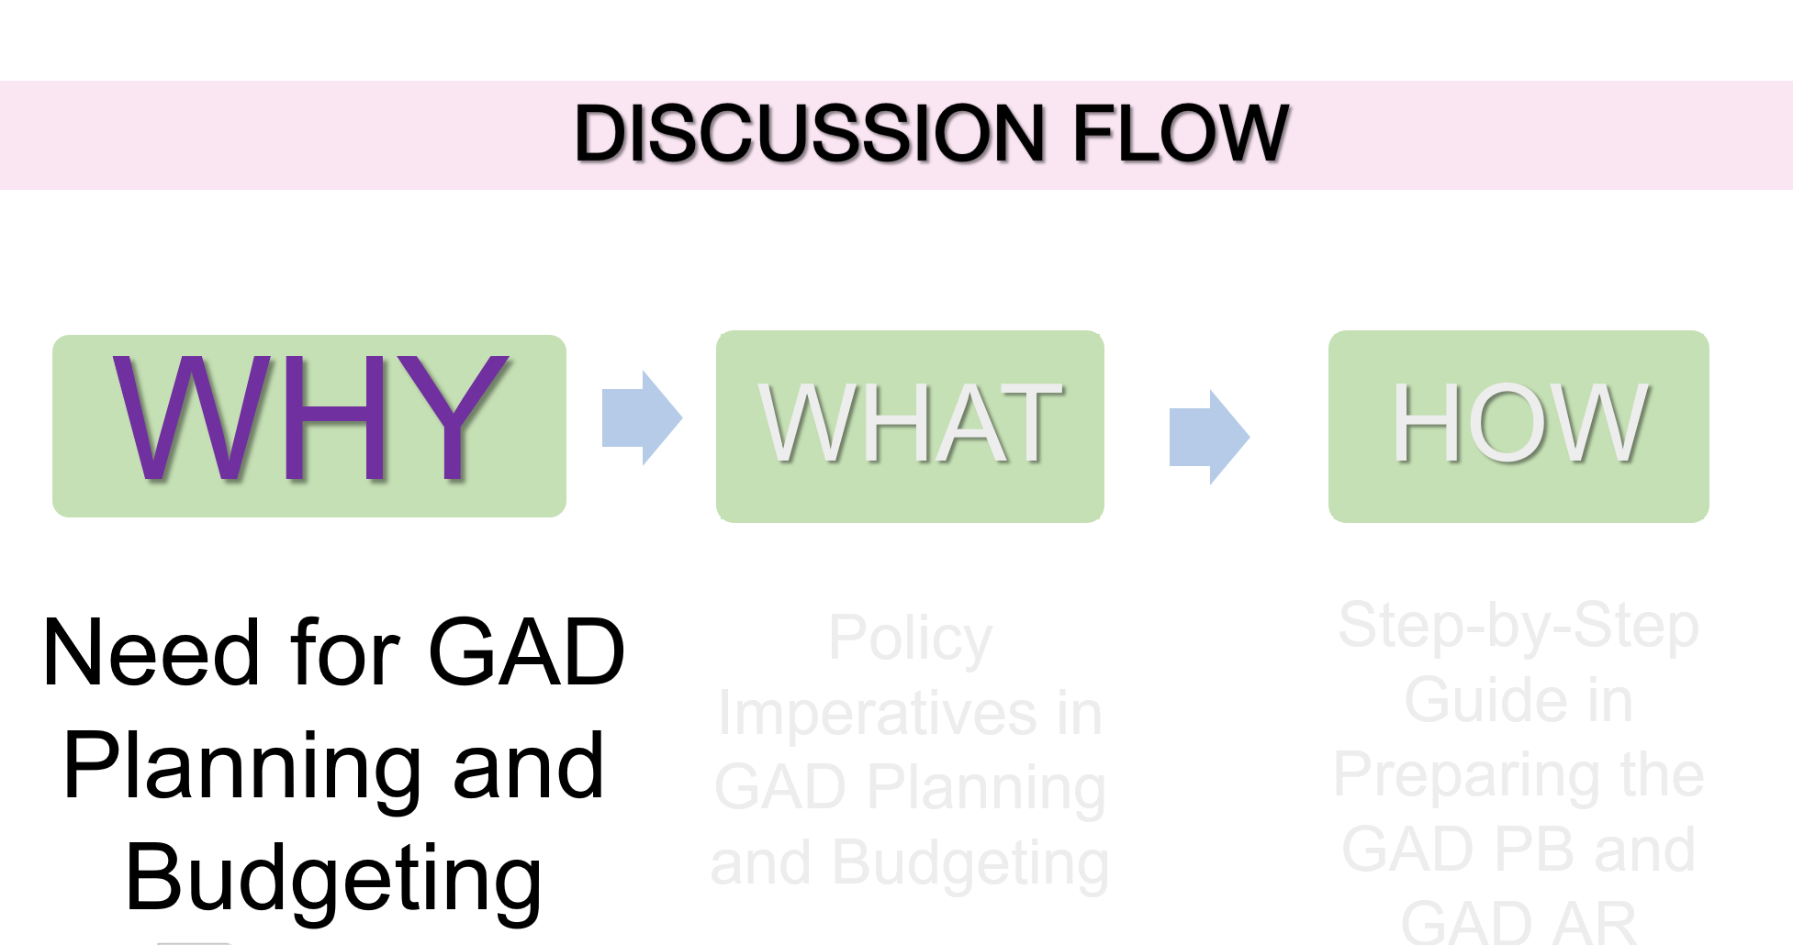
DISCUSSION FLOW

Slide 9
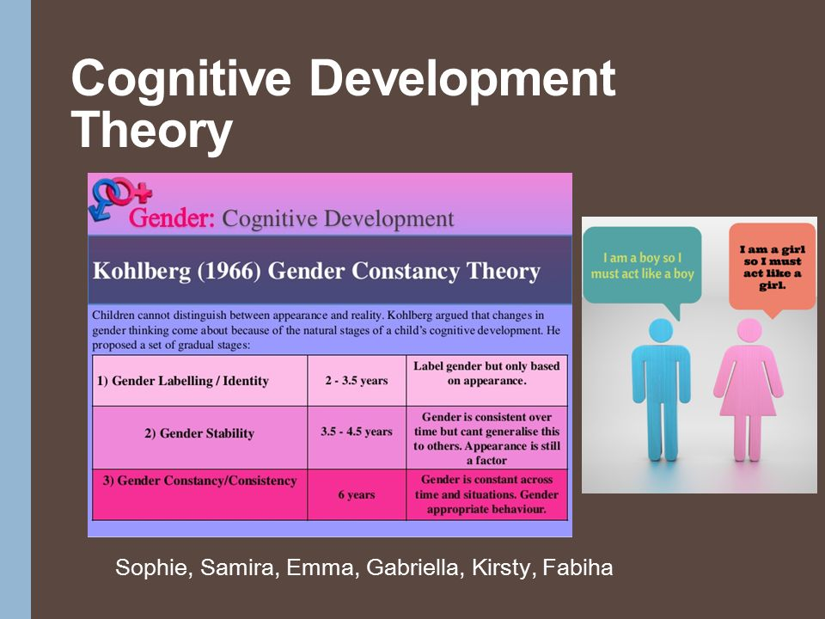
Why the need for GAD Planning and Budgeting?
Gender Stereotyping
Women and men are treated differently in our society.
Differences in the life situation of women and men.
Roles, expectations, needs, and interests
If development initiatives failed to consider these differences -GENDER INEQUALITY 🡪 GENDER ISSUES
Notes:
Gender and Development (GAD) planning and budgeting are crucial because men and women are often treated differently in society. These differences come from the different roles, expectations, and needs of each gender. If the government doesn’t consider these differences when making decisions, it can lead to unfairness and gender inequality. GAD planning and budgeting aim to address these issues by ensuring that resources and policies are fair and promote equality between men and women.

Slide 10




Why the need for GAD Planning and Budgeting?
WE NEED TO PRACTICE GENDER-RESPONSIVE GOOD GOVERNANCE
LIMITED RESOURCES
  Government agencies cannot achieve good governance without being transparent, participatory, equitable, and gender-responsive.
GENDER ISSUES, WHICH ARE OFTEN OVERLOOKED, HAVE TO BE ADDRESSED.
MAINSTREAMING GENDER PERSPECTIVE IN:
Institutional Development
Development Planning
*Slide and/or text from Atty. Mylen Gonzales-Esquivel PowerPoint Presentation

Slide 11



Why the need for GAD Planning and Budgeting?
GENDER and DEVELOPMENT
Development PERSPECTIVE and PROCESS that is
  Participatory and empowering
  Equitable
  Sustainable
  Free from violence
  Respectful of human rights
  Actualization of human potentials
Seeks to achieve GENDER EQUALITY as a FUNDAMENTAL VALUE that SHOULD be reflected in development CHOICES
Contends that women are ACTIVE AGENTS of development
Notes:
Gender and Development (GAD) Planning and Budgeting are key for effective governance because they focus on addressing gender issues in policymaking. This approach ensures that government decisions and budgets consider the different needs of all genders and promote fairness. By doing this, even with limited resources, governments can make better, more inclusive choices that help reduce gender inequalities and support good governance.

Slide 12

Why GAD?
GAD is about being faithful to the principle that……
DEVELOPMENT IS FOR ALL!
Fairness and equity demands that everyone in society, whether male of female, has the right to the same opportunities to achieve a full and satisfying life.
2

Slide 13
Why the need for GAD Planning and Budgeting?
There exist policy imperatives that mandate government instrumentalities to do so.
Notes:
What are these policy imperatives?

Slide 14
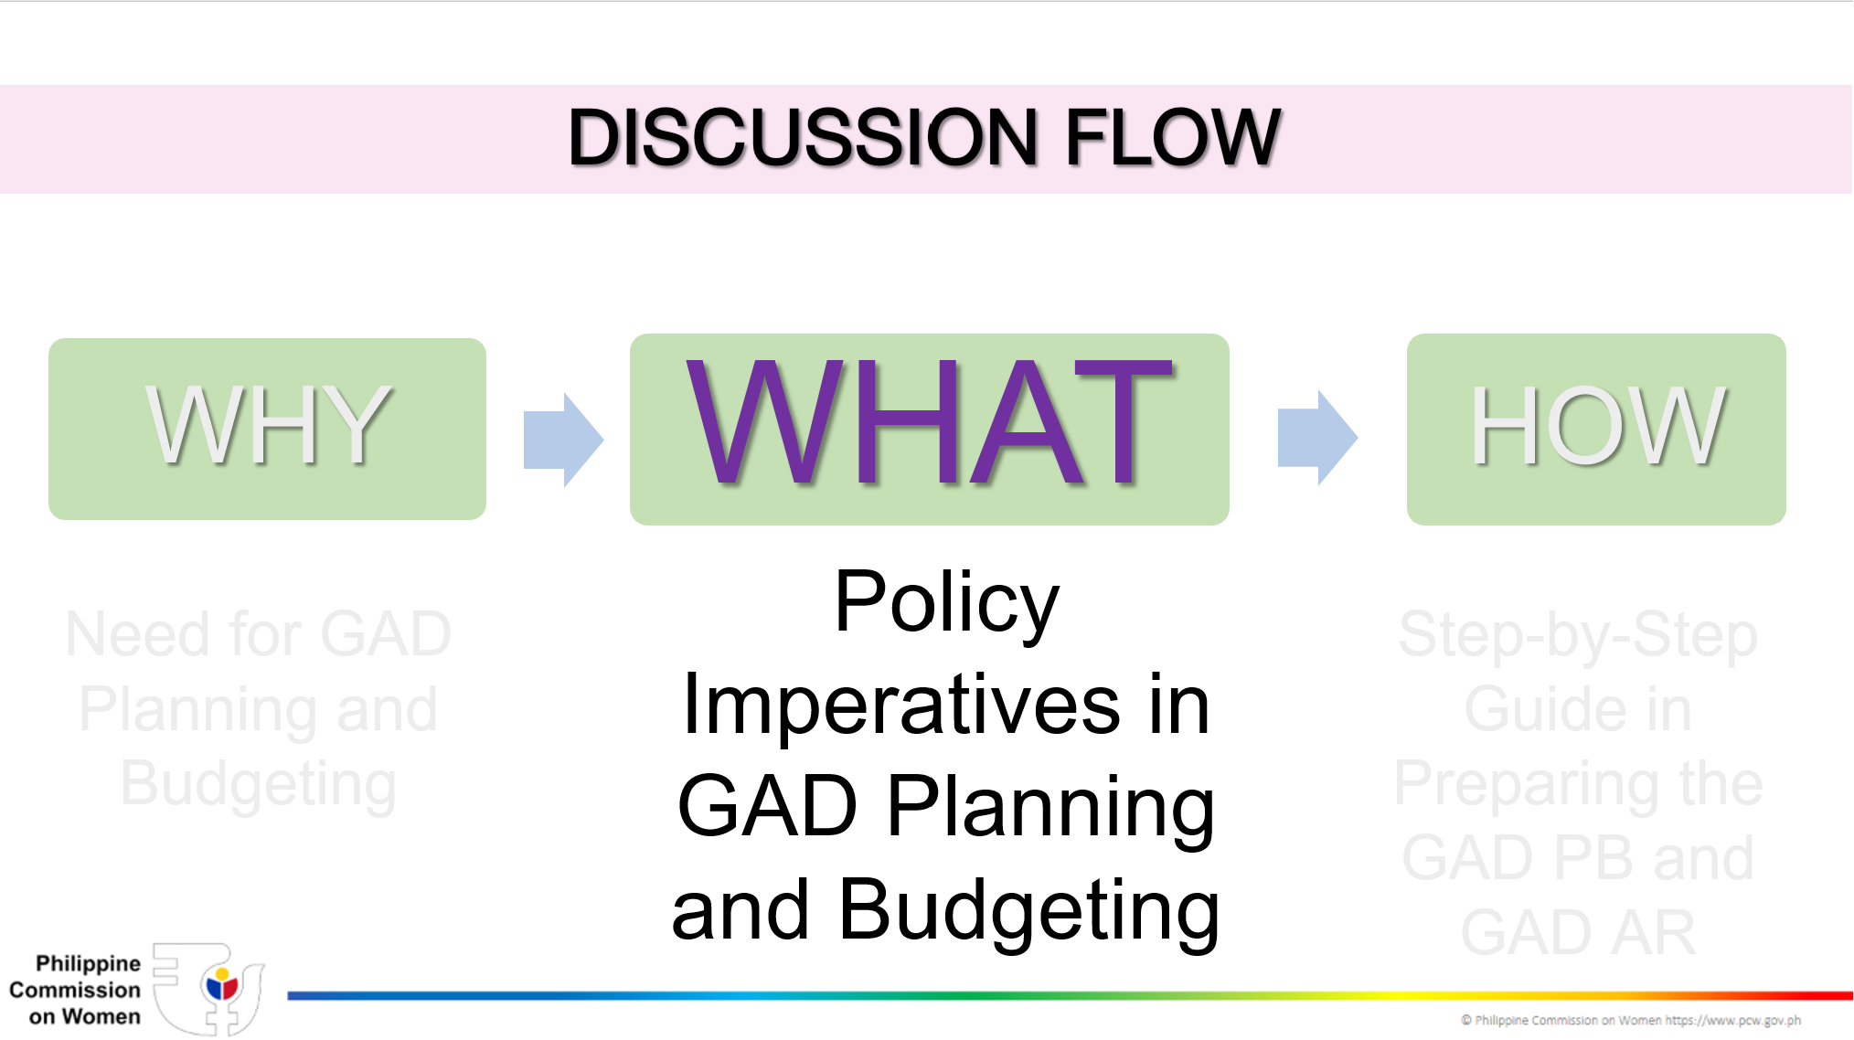
DISCUSSION FLOW

Slide 15
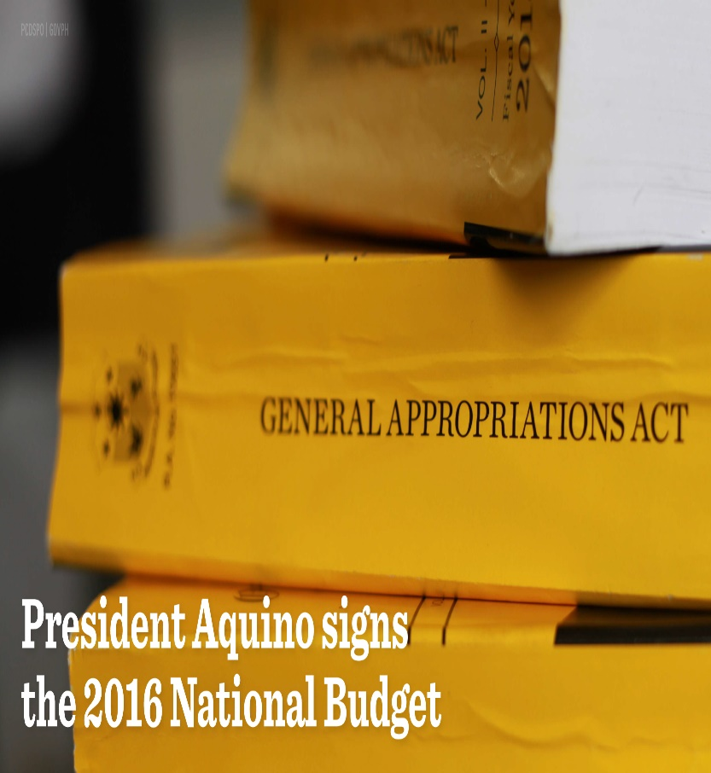

Policy Imperatives on GAD Planning and Budgeting
General Appropriations Act of 1995
“At least five percent (5%) of the total agency budget appropriations authorized under the annual GAA shall correspond to activities supporting GAD plans and programs.
Notes:
Moreover, the General Appropriations Act in 1995 introduced the The Gender and Development (GAD) budget policy as “The Women's Budget” to support with actual resources the implementation of programmes and projects on the ground, focused on gender advocacy and commitment to women's empowerment.
This policy directs all government departments and agencies to allocate a minimum of five percent (5%) of their total annual budgets for gender programs, projects and activities. It has been an important feature of the annual GAA and further strengthened by the Magna Carta of Women (RA 9710).

Slide 16

SEC. 36. Gender Mainstreaming as a Strategy for Implementing the Magna Carta of Women. –All departments, including their attached agencies, offices, bureaus, state universities and colleges, government-owned and –controlled corporations, local government units, and other government instrumentalities shall adopt gender mainstreaming as a strategy to promote women’s human rights and eliminate gender discrimination in their systems, structures, policies, programs, processes.
GAD programs addressing gender issues and concerns shall be designed and implemented based on the mandate of government agencies and local government units, Republic Act No. 7192, gender equality agenda of the government and other GAD-related legislation, policies, and commitments.

Slide 17
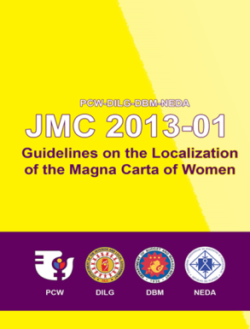
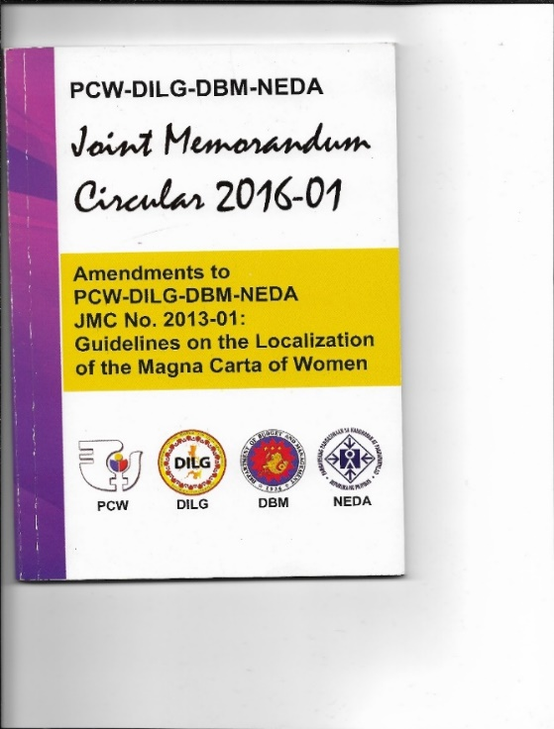
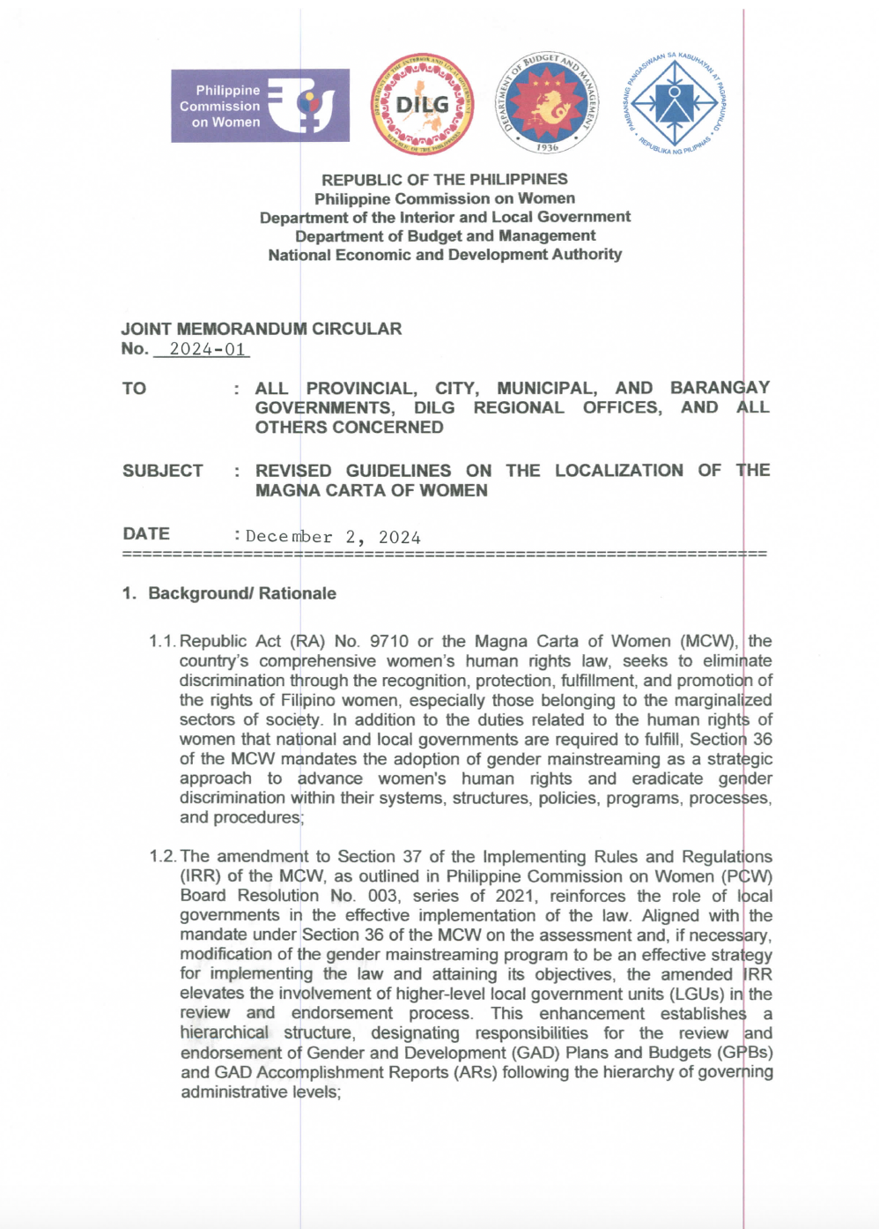
PCW-DILG-DBM-NEDA 2024-01
REVISED GUIDELINES ON THE LOCALIZATION OF THE MCW
OLD GUIDELINES

Slide 18
1.2 This enhancement establishes a hierarchical structure, designating responsibilities for the review and endorsement of Gender and Development (GAD) Plans and Budgets (GPBs) and GAD Accomplishment Reports (ARs) following the hierarchy of governing administrative levels;
1.3 The pursuit of women’s empowerment and gender equality under the MCW is also reinforced through various national laws and international human rights standards and commitments, which include, but are not limited to the following: RA No. 7160 or the Local Government Code of 1991 (LGC), the General Appropriations Act (GAA), the United Nations (UN) Convention on the Elimination of All Forms of Discrimination Against Women (CEDAW), the Beijing Declaration and Platform for Action (BPfA), and the Sustainable Development Goals (SDGs);

Slide 19
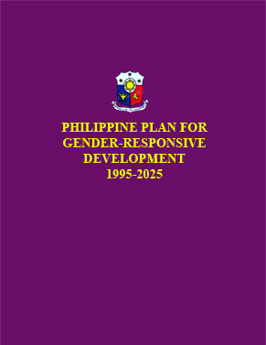


1.7. LGUs are also mandated to advance the general welfare, deliver fundamental services, and establish gender-responsive facilities, alongside the implementation of gender-responsive programs, projects, and activities (PPAs) in accordance with Sections 16 and 17 of the LGC, the Philippine Plan for Gender Responsive Development (PPGD), 1995-2025, the Philippine Development Plan (PDP), the National Action Plan for Women, Peace and Security (NAPWPS), and subsequent term plans on women and gender equality.

Slide 20

GENERAL GUIDELINES
4.1 Local officials and employees shall be responsible in promoting and ensuring that gender and development is mainstreamed in local policy-making, planning, programming, budgeting, implementation, monitoring and evaluation; In this regard, LGUs shall ensure that their GAD Focal Point System (GFPS) or similar GAD mechanisms are in place, fully-functional and the members have the capacity and influence to promote gender mainstreaming pursuant to Section 37 of the MCW Implementing Rules and Regulations (MCW IRR).

Slide 21
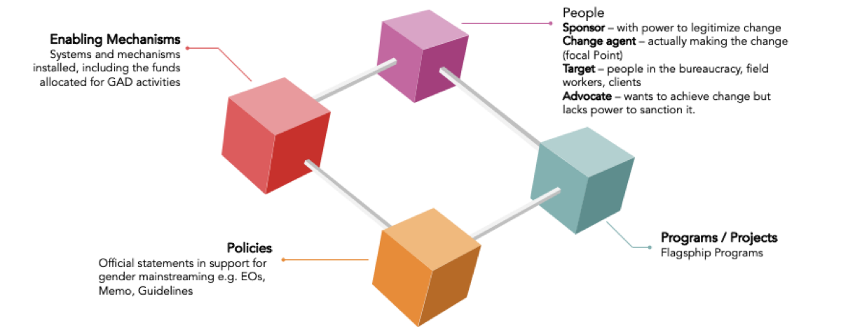
Gender Mainstreaming Entry Points

Slide 22
Development Planning Cycle & Gender Mainstreaming Entry Points
Programming & Budgeting
Planning
Monitoring & Evaluation
Implementation
Investment programming in the context of the LGU’s planning and development function involves generating the programs and projects derived from the detailed elaboration of the CLUP and the CDP.

Slide 23
GENERAL GUIDELINES
4.2 LGUs shall deepen their knowledge and build their competencies on GAD-related laws and
international commitments, gender mainstreaming, gender analysis, gender-responsive planning
and budgeting, and GAD-related tools among others;
4.3 LGUs shall ensure active participation of local committees/councils in partnership with
national/regional government agencies, academe, private sector and civil society organizations
(CSOs) operating at the local level for effective gender mainstreaming;

Slide 24
GENERAL GUIDELINES
4.4 LGUs shall establish and/or strengthen their monitoring and evaluation systems to assess the
effectiveness and efficiency of their gender mainstreaming efforts;
4.5 In compliance with the Full Disclosure Policy, LGUs shall post in conspicuous places, websites or
print media their progress in gender mainstreaming including the utilization of the GAD budget. In the absence of websites, LGUs may upload in the DILG Regional or Central Office websites; and

Slide 25
GENERAL GUIDELINES
4.6 Oversight agencies such as the DILG, PCW, DBM, and NEDA shall provide technical assistance to LGUs on matters related to gender mainstreaming and the implementation of these guidelines

Slide 26
5.0 INSTITUTIONAL MECHANISMS
TO IMPLEMENT THE MAGNA CARTA
OF WOMEN (MCW)

Slide 27





INSTITUTIONAL MECHANISMS TO IMPLEMENT THE MAGNA CARTA OF WOMEN (MCW)
1
3
5
Creation and/or Strengthening of the LGU GAD Focal Point System
GAD Planning and Budgeting
LGU GAD Code
2
4
Establishment and Maintenance of GAD Database
Mainstreaming Gender Perspectives in Local Development Plans

Slide 28
Creation and/or Strengthening of the LGU GAD Focal Point System

Slide 29
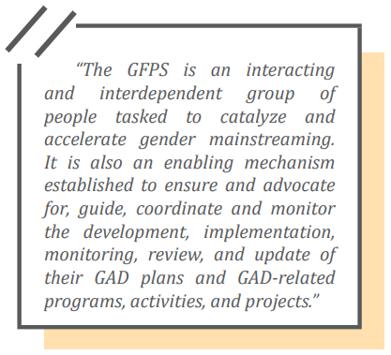



The GAD FOCAL POINT SYSTEM
“The GFPS is an interacting and interdependent group of people tasked to catalyze and accelerate gender mainstreaming. It is also an enabling mechanism established to ensure and advocate for, guide, coordinate and monitor the development, implementation, monitoring, review and update of their GAD plans and GAD-related programs, activities, and projects.”
Source: PCW MC 2011-01

Slide 30


How to establish GFPS?
The heads of agencies/local chief executives of LGUs shall issue appropriate directives to institutionalize the creation of the GFPS in their respective agencies/LGUs;
Agencies/LGUs with existing GFPS or similar mechanisms shall reconstitute and strengthen said mechanisms based on the provisions of RA 9710, its IRR and the following policies:
PCW Memorandum Circular 2011-01 for agencies /SUCs / GOCCs;
PCW-DILG-DBM-NEDA Joint Memorandum Circular 2024-01 for LGUs
CHED Memorandum Order 2015-01

Slide 31
GFPS Structure (ExeCom)
CHAIR
Local Chief Executive (LCE)
ALTERNATE CHAIR (optional)
Designated by LCE
LGU GAD Office
VICE-CHAIR (optional)
Designated by LCE
MEMBERS
- Heads of LGU departments and other offices relevant to Gender Mainstreaming:
- Chairs of the following Sanggunian Committee:
- Women, Children and Family
- Appropriations
- Representative/s from the following groups:
- PNP Women’s Desk - Women’s Organization or recognized NGO
- Indigenous Peoples (IPs) (where existent) - Private Sector
- Persons With Disabilities (PWDs) - Academe
- President of the Liga ng mga Barangay (applicable only for cities and municipalities)
- Sanggunian Kabataan (SK) Federation President (applicable only for cities and municipalities)
- President of the Mayor’s League (applicable only for provinces)
- President of the Liga ng mga Barangay and Sanggunian Kabataan (applicable only for provinces)
Note: These are the minimum requirements, however, this should not limit the LGU from adding additional members as may be deemed necessary.

Slide 32
5.1.3.3. LGU GAD Office. Where feasible, the LGU may also establish a GAD Office or unit under the Office of the LCE to support and coordinate all GAD-related PPAs and concerns of the LGU GFPS. The LCE may also appoint or designate the LGU personnel to manage the GAD office and/or unit.
5.1.3.3.1. The GAD Office shall not replace the LGU GFPS. If present, the GAD Office or unit shall work in coordination with the GFPS and function as the GFPS Secretariat.
5.1.3.3.2. The LCE may appoint or designate the LGU personnel to manage the GAD office and/or unit. The head of the GAD Office and its key staffers shall be members of the GFPS EXECOM and/or TWG, as appropriate.

Slide 33
GFPS Structure (TWG)
CHAIR
Elected from among the TWG members
SECRETARIAT
The GFPS TWG Chair may designate a secretariat to assist the TWG in its functions.
MEMBERS
Key staff committees represented in the EXECOM and the relevant LGU departments, but not limited to the following:
- Planning and Development Office
- Social Welfare and Development Office
- Human Resource and Management Office
- Budget Office
- Accounting Office
- Treasurer’s Office
- Health Office
- Agriculture Office
- Office of the LCE
Representatives from the following groups:
- Private Sector - Civil Society/People’s Organizations
- Academe - Persons with Disabilities

Slide 34
Barangay GFPS
CHAIR
Punong Barangay
CO-CHAIR
Chair of the Sanggunian Barangay Committee on Women, Children and Family
SECRETARIAT SUPPORT
Barangay Secretary
MEMBERS
  Barangay Health Worker
  Barangay Human Rights Action Officer (where existent)
  Barangay Nutrition Scholar
  Barangay Treasurer
  Day Care Worker
  Lupong Tagapamayapa Member
  Sanggunian Barangay Committee on Appropriations
  SK Chairperson
  Tanod Executive Officer
  Violence Against Women (VAW) Desk Officer
  Representation from Women’s organization/s existing in the barangay level

Slide 35
General Functions of the GFPS
Lead gender mainstreaming initiatives/efforts
Formulate GAD policies
Capacitate all personnel on GAD
Set up appropriate mechanism
Creation/Strengthening of GFPS
Promote and pursue participation of women
Coordinate GAD efforts of the different units
Strengthen external link with other agencies on GAD
Prepare GAD Plan and Budget and GAD Accomplishment Report
Lead in monitoring the implementation of GPB

Slide 36
5.1.9.10. Ensure that all personnel of the LGU, including the planning and finance officers (e.g., accountants, budget officers, and auditors), are capacitated on GAD. Along this line, the GFPS will recommend and plan an appropriate capacity development program on GAD for its employees as part of and implemented under its regular human resource development program; and
5.1.9.11. The GFPS of the province/city/municipality through their respective (TWGs) shall facilitate the review and endorsement of GPBs of LGUs within their jurisdiction based on the alignment of the GPB to the Provincial Development and Physical Framework Plan (PDPFP), the Comprehensive Development Plan (CDP), the Local Development Investment Program (LDIP), and the Annual Investment Program (AIP); on the gender responsiveness of content (i.e., relevance of the GAD PPAs to the identified gender issues); and the correctness and alignment of entries in the GPB form.

Slide 37
Roles and Responsibilities
GFPS Chairperson
Issue Policies
Approve GPB and ensure its implementation
Direction setting and advisory to head of agency on GAD
Lead identification of GAD strategies
Ensure timely submission of GPBs and ARs
Monitor effective implementation of GAD plan and use of GAD budget
Lead in forging partnerships on GAD
Recommend Approval of agency GPB and GAD AR
Recommend awards and recognition for good performing GFPS members
GFPS EXECOM

Slide 38
Roles and Responsibilities
Formulate GPB and GAD AR
Assist in CapDev or provide TA in coordination with HRD
Coordinate with all concerned on their meaningful participation in GAD efforts
Conduct advocacy and develop IEC materials to drum up support for agency GAD efforts
Monitor implementation of GAD PPAs
Submit reports and recommendations to agency head
Review all submitted GPBs of their component LGUs and provide comments or recommendations for revision as needed.
GFPS TWG/ Secretariat

Slide 39
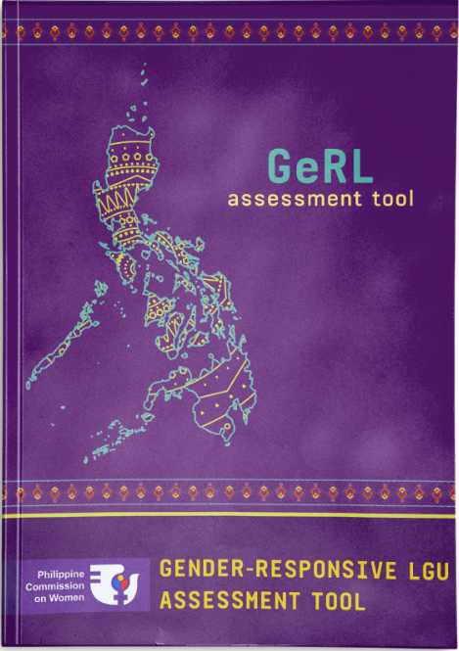
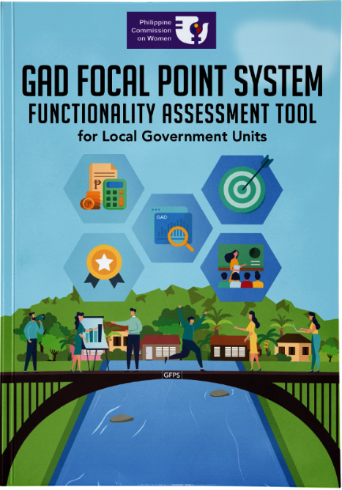
5.1.7. To ensure that LGUs have improved in their gender mainstreaming efforts, all LGUs shall assess their gender-responsiveness as an organization and the delivery of their basic services and facilities every three years, using the GeRL Assessment Tool. The Tool can be downloaded from the PCW website through this link: https://library.pcw.gov.ph/gender-responsive-lgu-gerl-assessment-tool/;
5.1.8. All LGUs shall administer the GFAsT for LGUs to assess the functionality of their GFPS and use the results to address the gaps and challenges to make their GFPS fully functional. The Tool can be downloaded from the PCW website through this link: https://library.pcw.gov.ph/gad-focal-point-system-functionality-assessment-tool-for-local-government-units/.

Slide 40
Establishment and Maintenance of GAD Database

Slide 41



Purpose of LGU GAD Database
To aid in gender analysis of the LGU situation by surfacing gender gaps and/or differences among women and men in terms of their access to basic services and facilities, control of resources and enjoyment of rights, privileges, benefits and rewards.
To inform the LGU on the extent of implementation and/or attainment of gender equality and women’s empowerment goals and outcomes.
To provide baseline data on the status of women and men in the LGU

Slide 42


Local Planning and Development Offices (LPDO)
GAD Database
can either be MANUALLY operated or DEVELOPED THROUGH SOFTWARE, shall form part of the overall management information system (MIS) of the LGU.
shall spearhead the setting up and maintenance of the GAD database
Notes:
The following are essential elements in GAD planning and budgeting as they enable agencies to more effectively plan and implement their sectoral programs on GAD. If these are not present or need to be strengthened, LGUs shall include them in their GPBs.

Slide 43







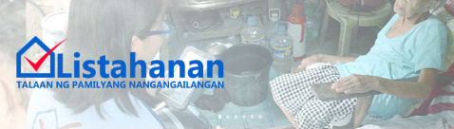

Sex disaggregated data (SDD) and GAD related information
may be derived and/or sourced from the ff:
Local NSO
Academe
CSOs
Studies
Surveys
Administrative
Reports of
local NGAs
SDD and results of the following may also form part of the GAD Database
National Household Targeting System
for Poverty Reduction
Notes:
of the local offices of NGAs such as: DA, DENR, DAR, DOLE, DTI

Slide 44
What is GAD-related Information?
It is sex-disaggregated data (SDD) and gender statistics
GENDER STATISTICS
data are collected and presented disaggregated by sex;
data reflect gender issues – questions, problems and concerns related to all aspects of women’s and men’s lives, including their specific needs, opportunities or contributions to society;
data collection methods take into account stereotypes and social and cultural factors that may induce gender biases.
Amended MCW IRR – The Philippine Statistics Authority (PSA), upon the recommendation of the Inter-agency Committee on Gender, Children and Youth Statistics (IACGCYS) shall issue statistical policies on the generation of data support on gender issues and improve the system of collection and dissemination of gender statistics at the national and local levels.
Currently, the PSA is piloting the GAD database guidelines with its member agencies, and NEDA as member of the inter-agency will be piloting the guidelines.

Slide 45
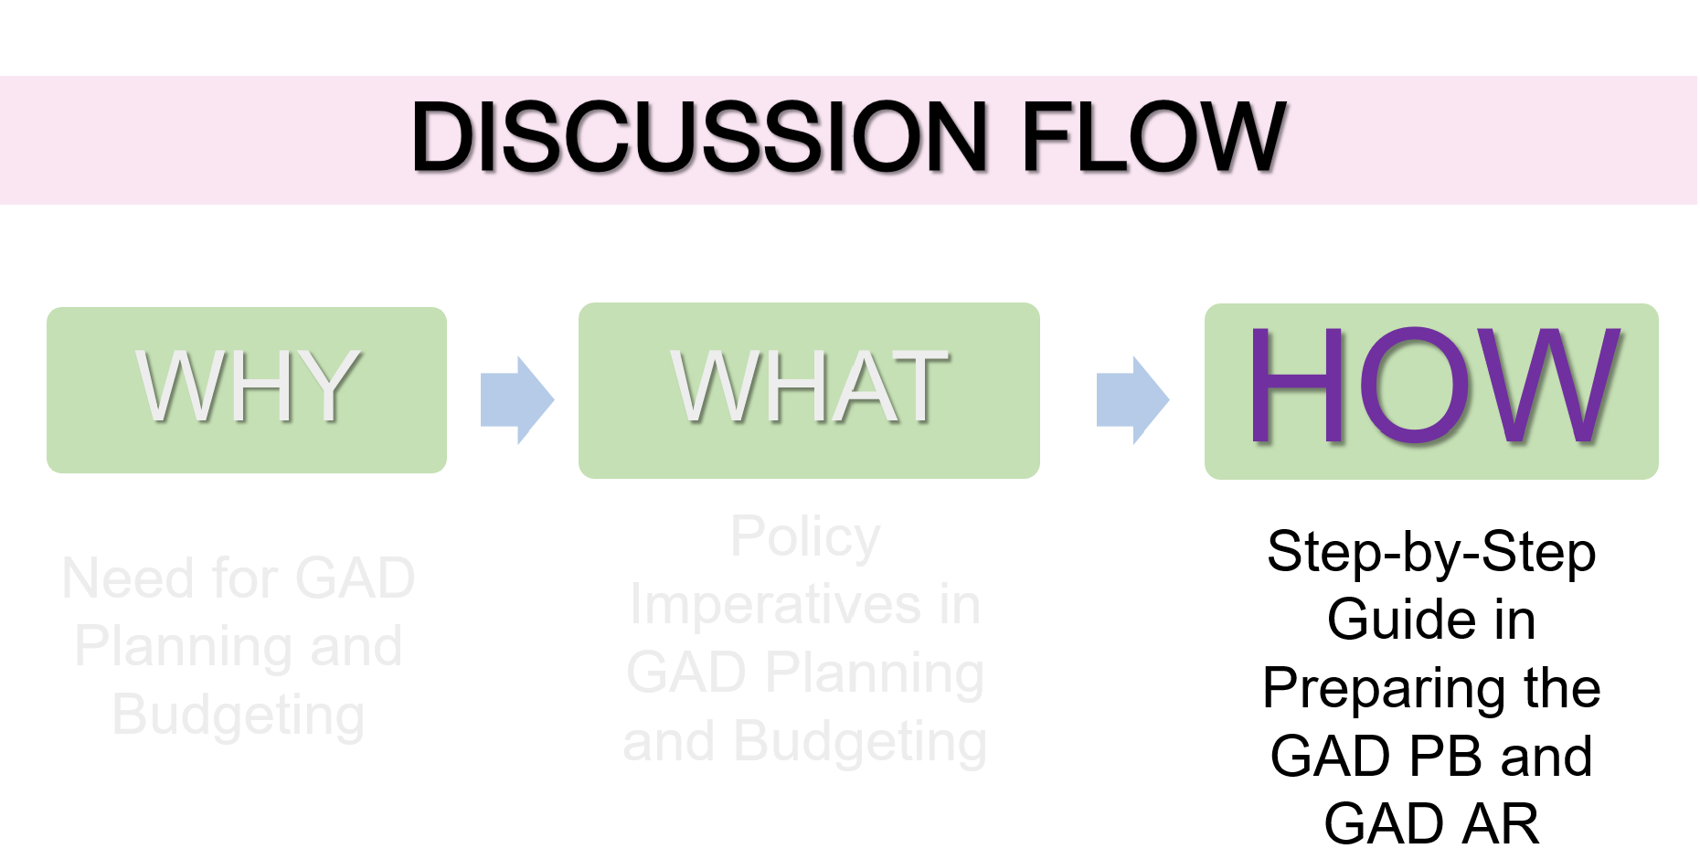

Slide 46
GAD Planning and Budgeting

Slide 47

WHAT IS A GAD PLAN?
A systematically designed set of programs, projects and activities to be implemented by an agency over a given period of time.
It addresses gender issues and concerns of the agency clients and of its personnel.
It’s an integral part of the agency annual plan.

Slide 48

Why the need for GAD Planning and Budgeting?
Different genders are socially conditioned to occupy different roles. They face different expectations and challenges. These biases are often subtle or invisible. Often, they’re not intentional or malicious.
Applying a gender lens means that those making plans, programs, and decisions view those with particular attention to gender imbalances or biases in what is being presented.
Using a gender lens reveals the ways in which content and approaches are gendered – informed by, shaped by, or biased toward men’s or women’s perspectives or experiences.

Slide 49
Four (4) Essential Elements in GAD Planning and Budgeting
Creation and/or Strengthening of the GAD Focal Point System
Capacity Building on Gender and Development
Conduct of Gender Audit
Institutionalization of GAD Database or Sex-Disaggregated Data

Slide 50

Steps in Formulating the GPB
1
In consultation with local functionaries and stakeholders, the LGU GFPS shall set the GAD Agenda or identify priority gender issues to be addressed by the LGU during the three-year term of its leadership. The GAD agenda shall be the basis for the annual formulation of PPAs to be included in the LGU GPB. GAD Agenda or the priority gender issues maybe derived from the following:
Review of GAD-related laws and policies
Results of gender analysis and/or gender assessment
Results of program and project evaluation
Review of findings from the audit of GAD Funds and GAD AR

Slide 51

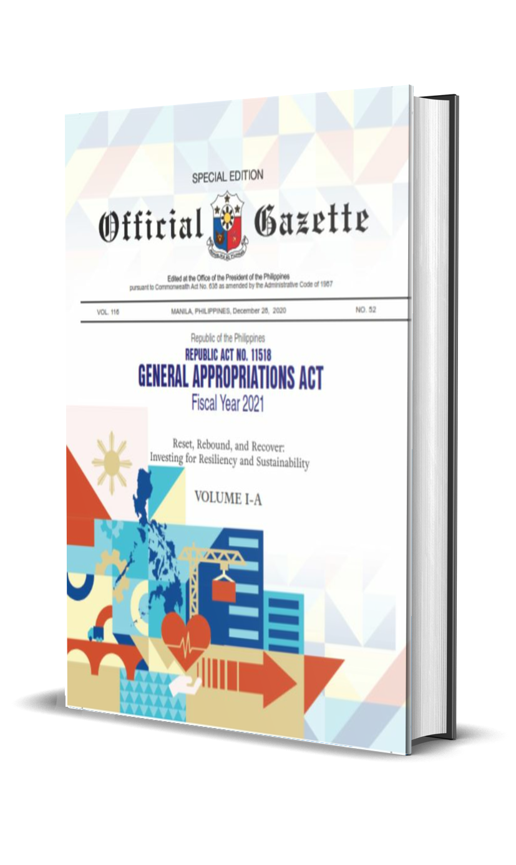
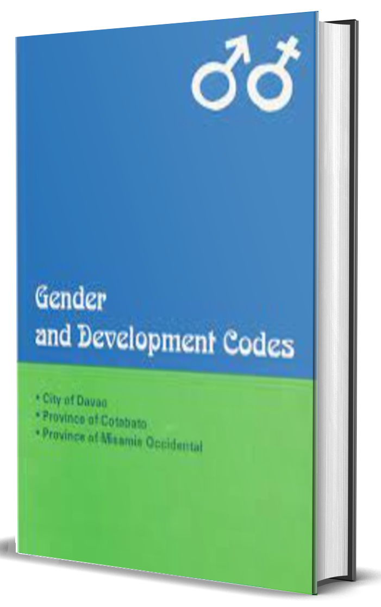

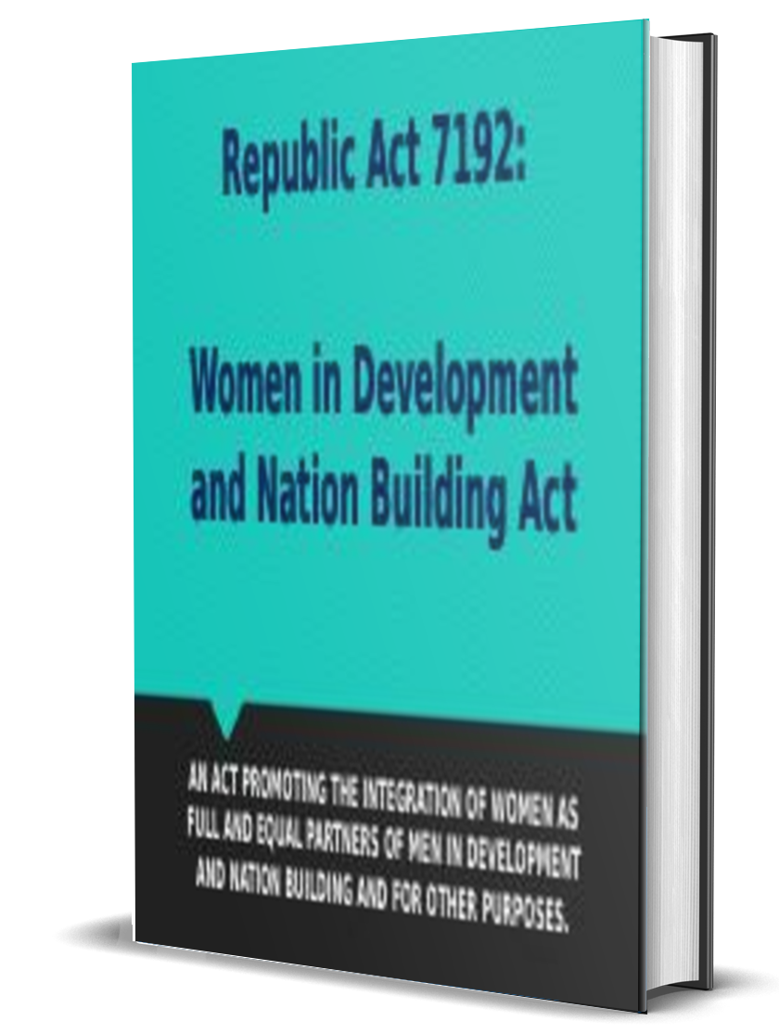

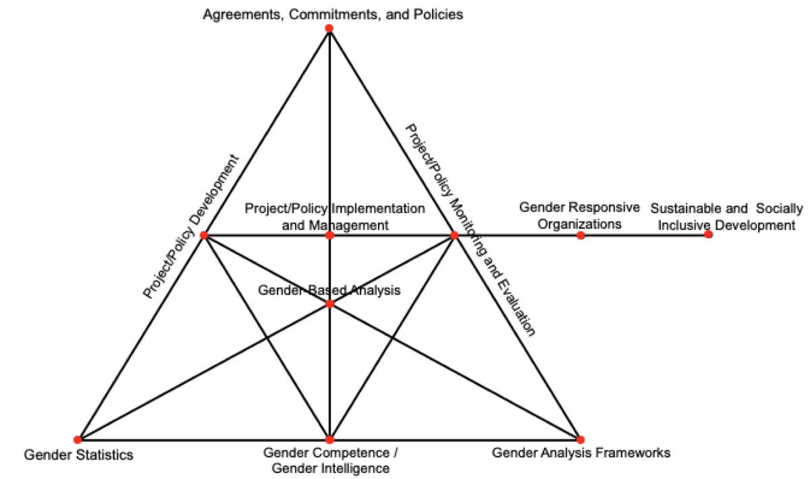

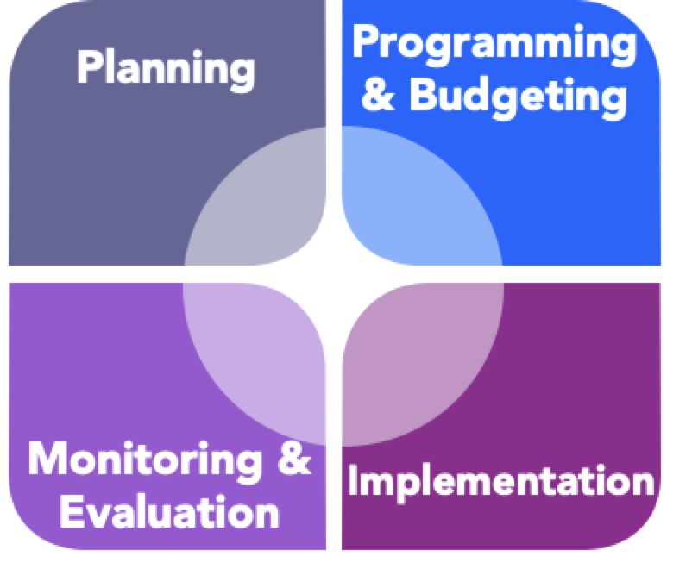
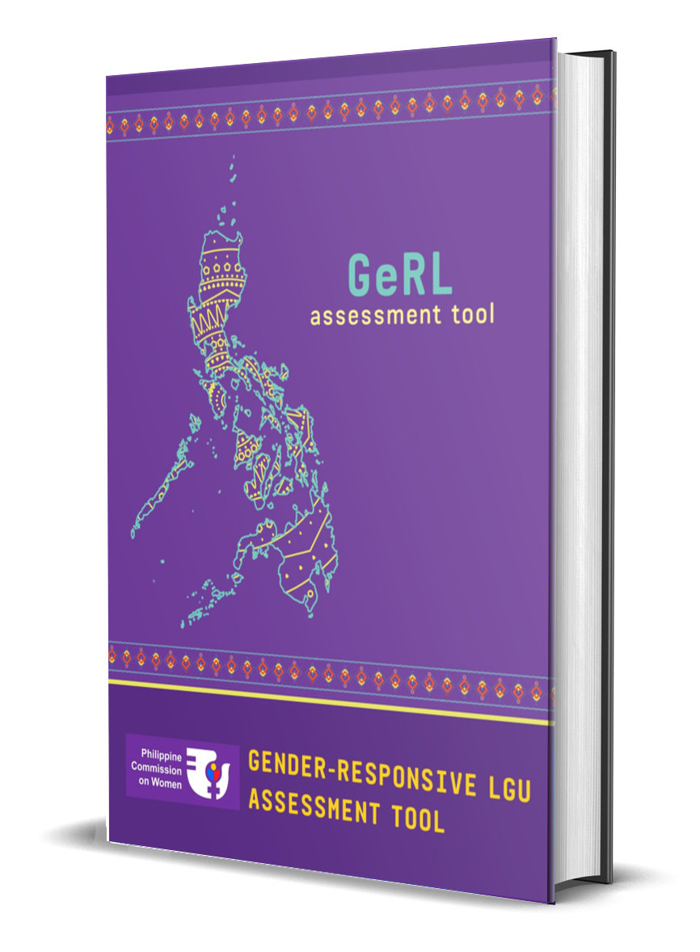
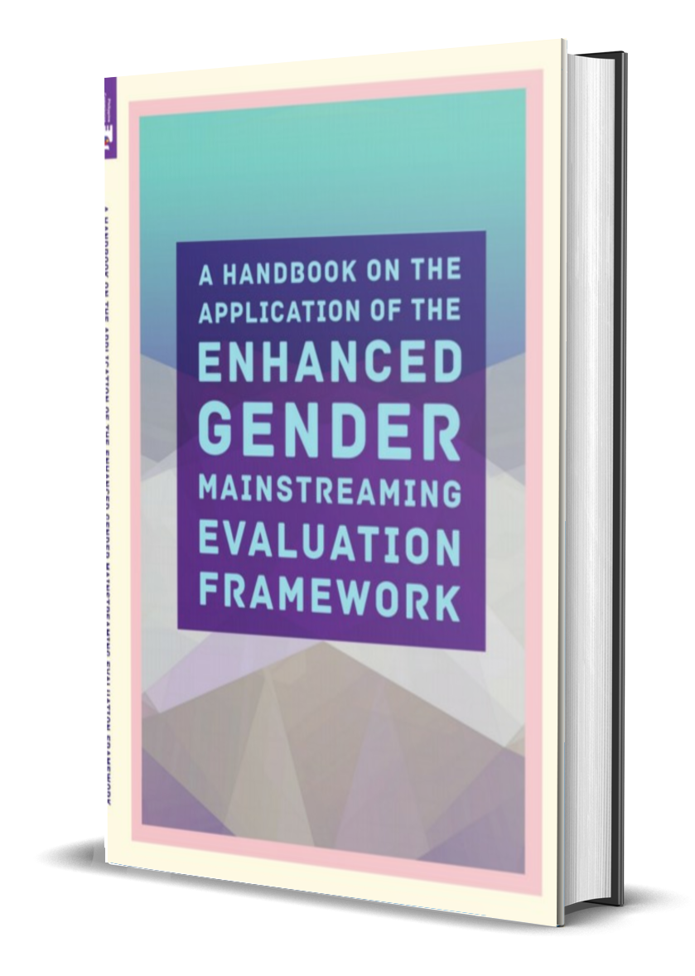

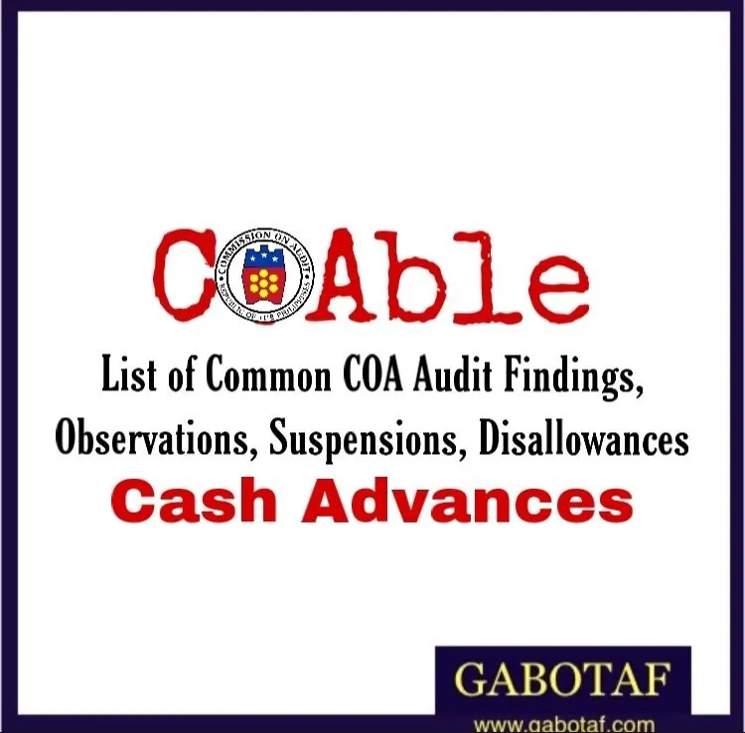
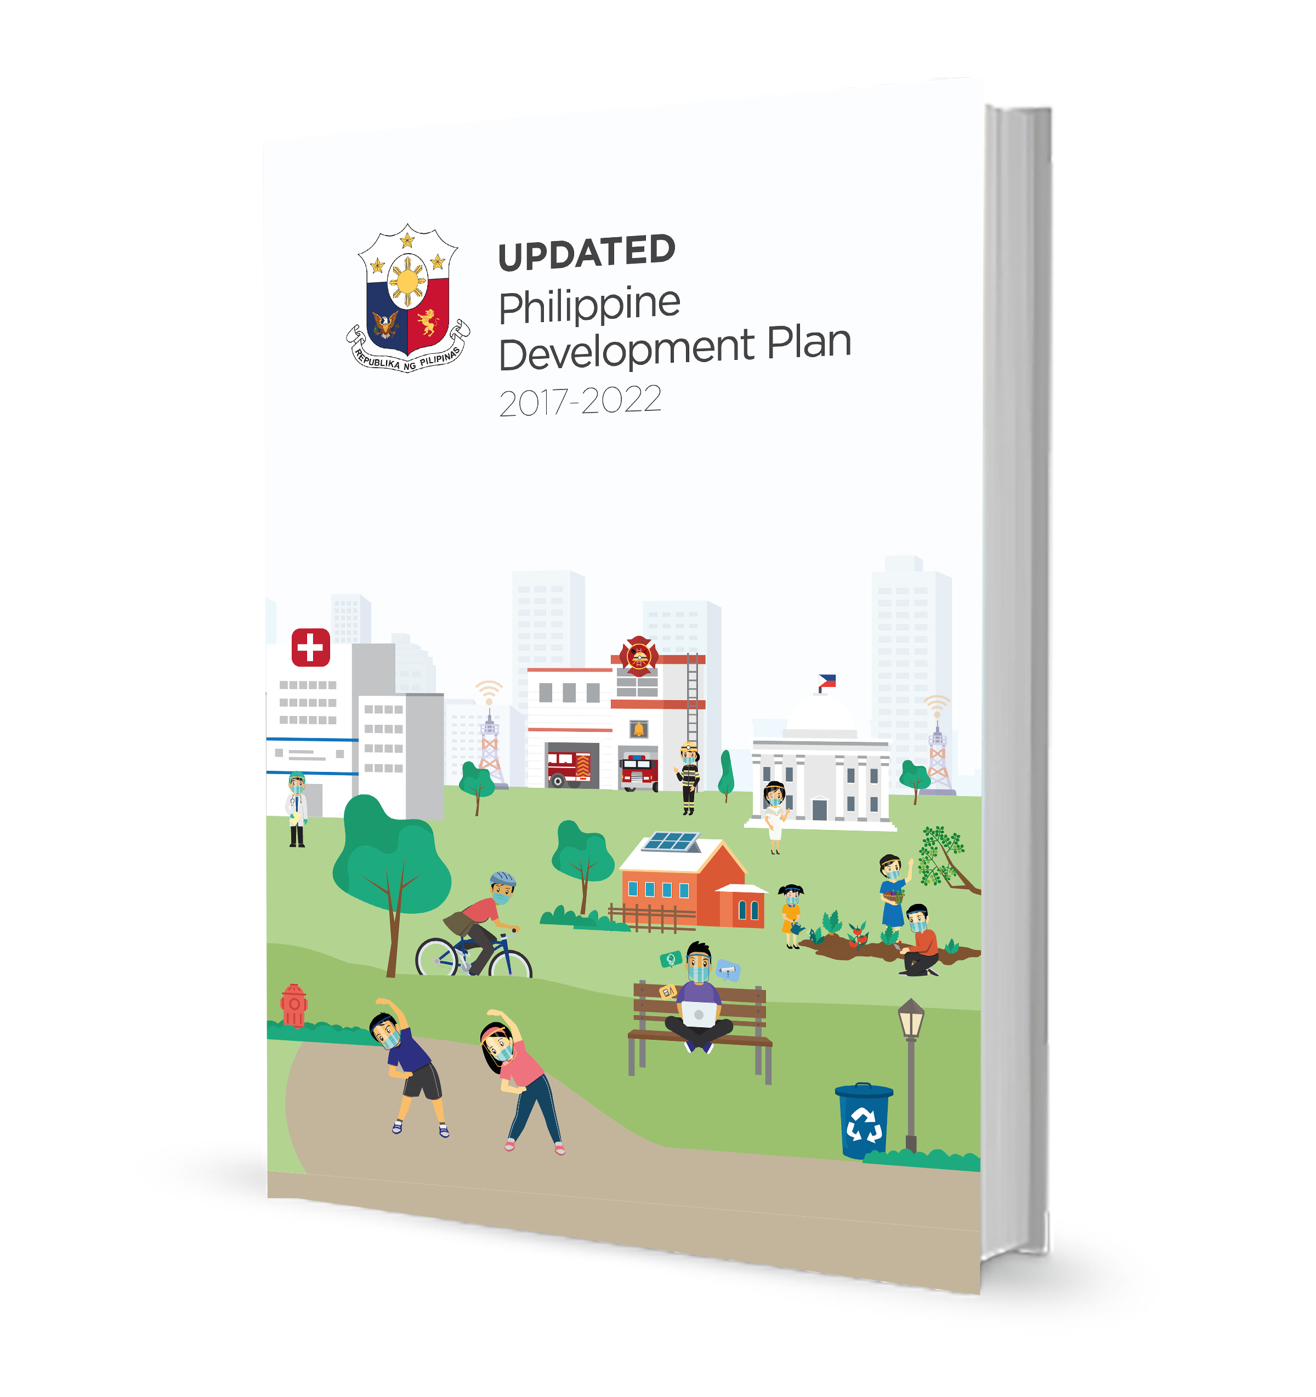

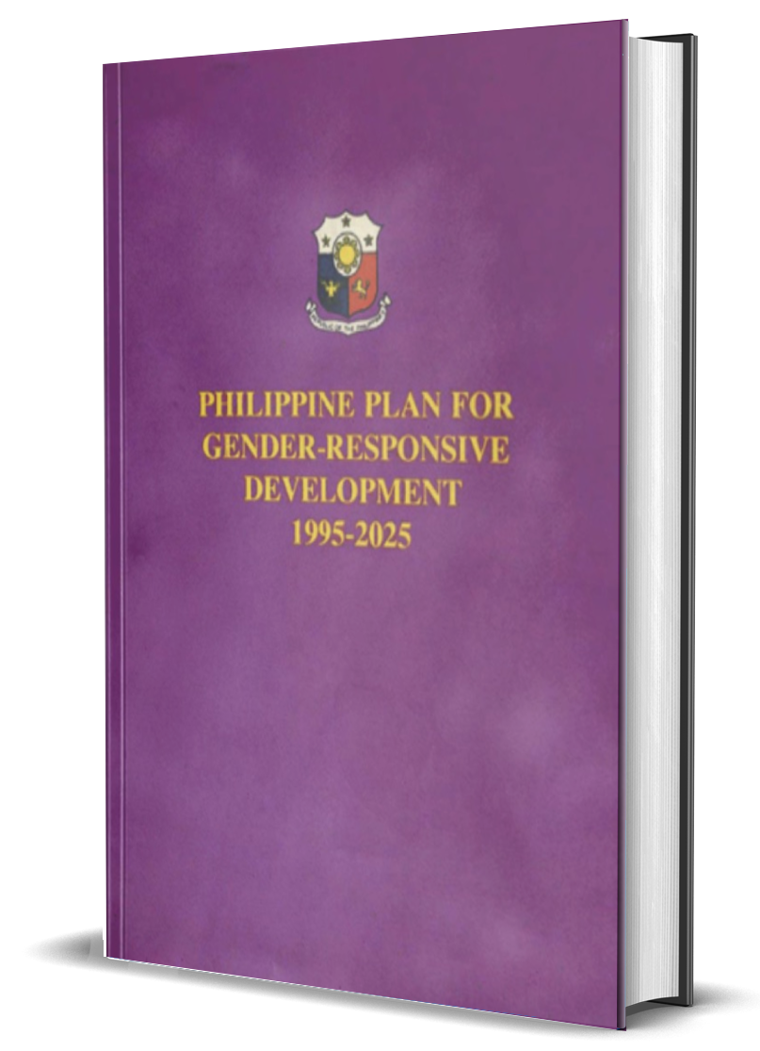
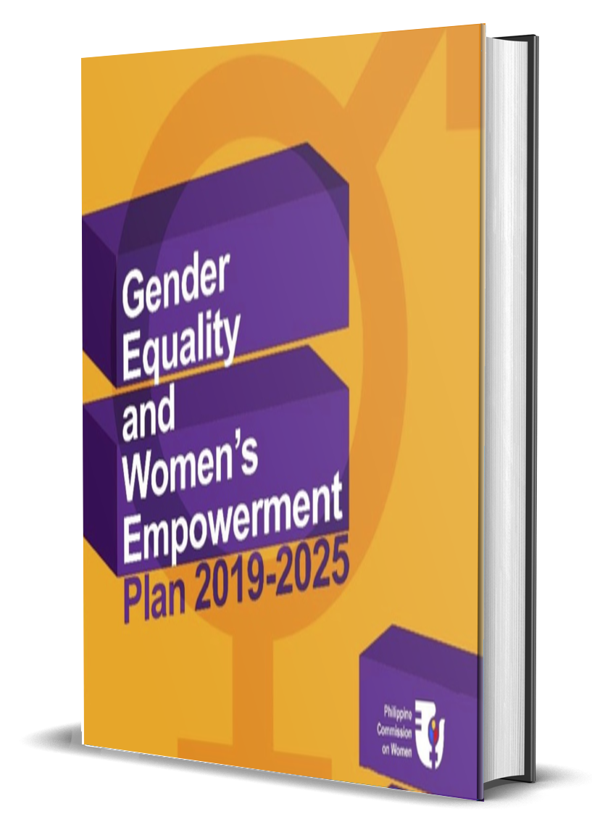


Guide Documents

Slide 52
Is a gender analysis tool designed to measure the extent of gender- responsiveness of LGUs:
1. As an organization
2. In its delivery of basic services and facilities

Slide 53

USERS OF THE GERL ASSESSMENT TOOL
Planning and Development Office
Directs and facilitates the process of administering the GeRL Assessment Tool
LGU GAD Focal Point System
Shall ensure the maximum participation of the LGU’s different units and organizations, prepare GAD-related documents as reference materials, and document the highlights of the assessment
PROVINCES
CITIES
MUNICIPALITIES

Slide 54
Steps in Formulating the GPB
2
IDENTIFY APPROPRIATE PAPS TO ADDRESS
PRIORITY GENDER ISSUES
GAD Mandate
refers to international, and local related laws or plans in advancing gender equality and women’s empowerment
Gender Issues (client/organization-focused)
refer to the problems and concerns that arise from unequal status of women and men including the differential characteristics, roles and expectations attributed by society to women and men
(PAPs may be client-focused or organization- focused)

Slide 55
In identifying GAD PPAs, LGUs shall at all times give priority to those that will address emerging and/or continuing issues and concerns on:
Provision of basic services and facilities to protect and fulfill women’s human rights, including their right to protection from all forms of violence;
Women’s economic empowerment, including women’s participation in economic governance;
Participation in local governance and decision-making; and
Other provisions of the MCW.

Slide 56


Steps in Formulating the GPB
3
GAD Budget is prepared based on the estimated cost of functions and PPAs translated from the demands/ commitments identified in the GAD Plan.
At least 5% of the total LGU budget appropriations authorized under the Annual Budget shall correspond to activities supporting GAD PPAs.
GAD budget is NOT an additional budget and it may be drawn from MOOE, PS and CO.
The 5% GAD budget shall endeavor to influence the remaining 95% of the LGU budget toward gender-responsiveness.

Slide 57
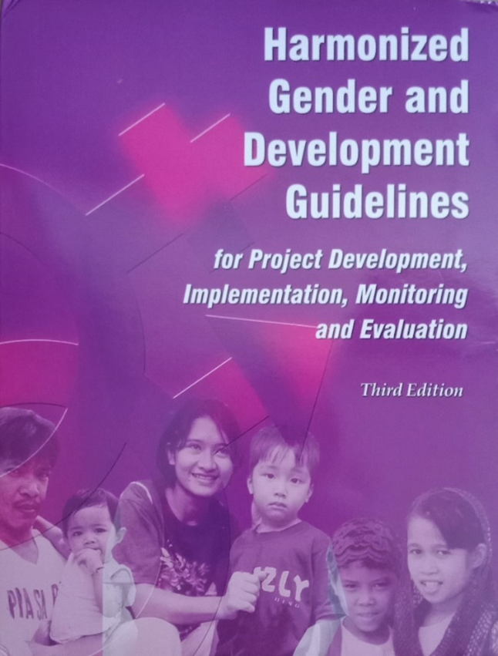
Steps in Formulating the GPB
4
APPLY THE HARMONIZED GAD GUIDELINES to assess the gender responsiveness of major programs and projects
Tool used to ensure that programs and projects undertaken by the government in their various stages are
gender responsive.

Slide 58
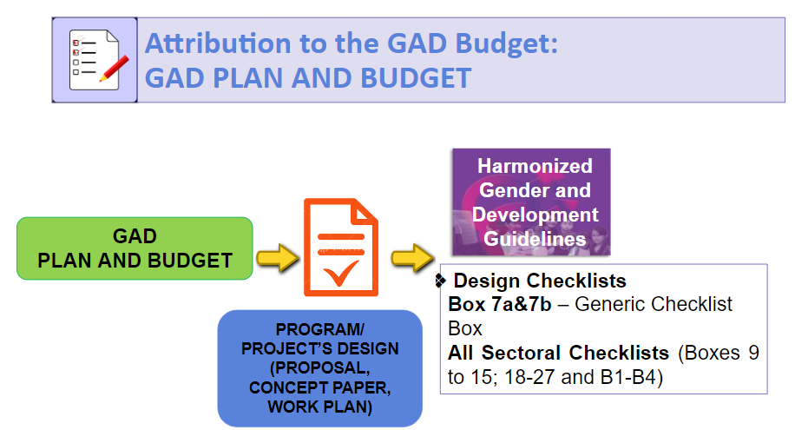

Slide 59
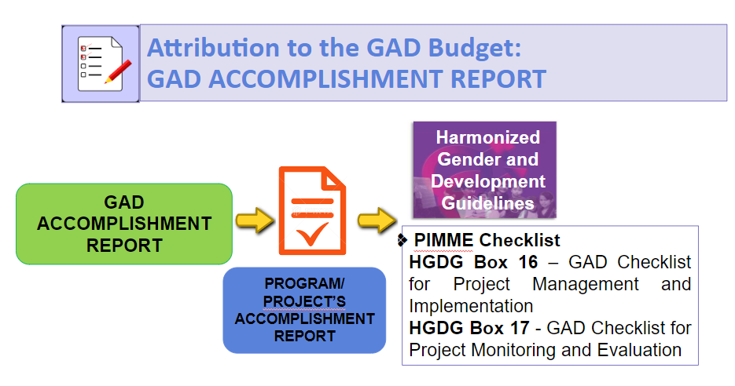

Slide 60
Attributing PAPs to GAD (LGUs)
The use of the HGDG will yield a maximum score of 20 points for each program or project.
HGDG Score | Description
0 – 3.9 | GAD is invisible in the program/project
4 – 7.9 | The program/project has promising GAD prospects
8 – 14.9 | The program/project is gender-sensitive
15-20 | The program/project is gender responsive

Slide 61
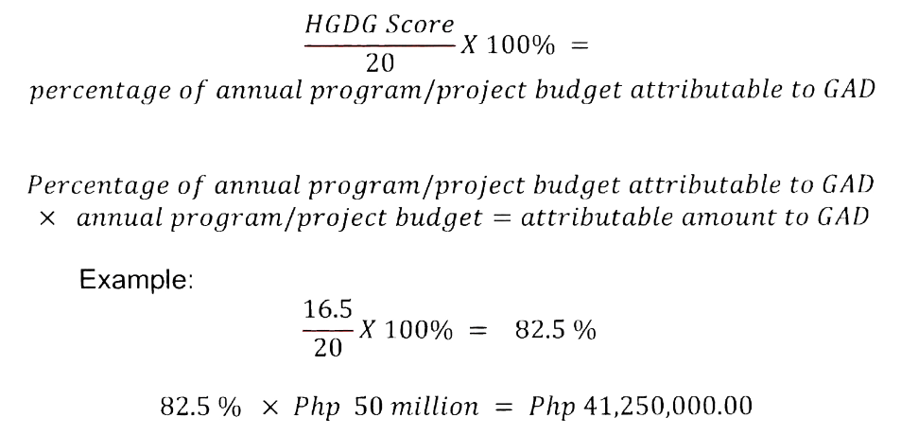
5.3.4.3.2. The percentage score of the HGDG assessment shall correspond to the percentage of the budget of the LGU’s existing and proposed major program/project that may be attributed to the GAD budget. The formula shall be as follows:
Thus, the budget of the program that may be attributed to GAD is Php 41,250,000.00.
5.3.4.4. Programs/projects with HGDG scores below 4.0 shall not be eligible for budget attribution. LGUs are, nonetheless, encouraged to identify direct GAD activities to enhance the gender-responsiveness of the program and its design based on the result of the HGDG assessment.

Slide 62
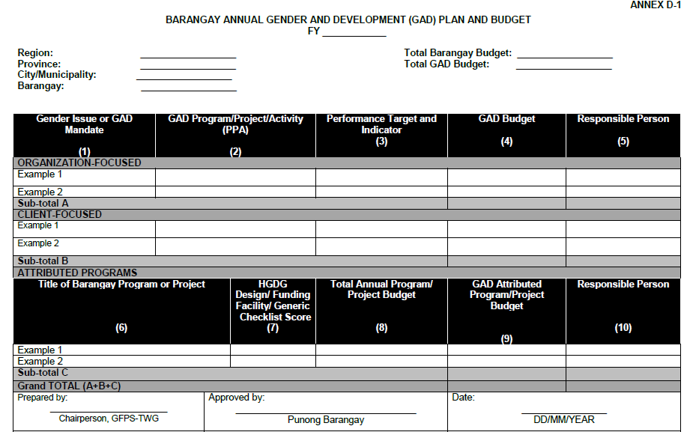
GAD PLAN AND BUDGET FORM BARANGAY LEVEL

Slide 63
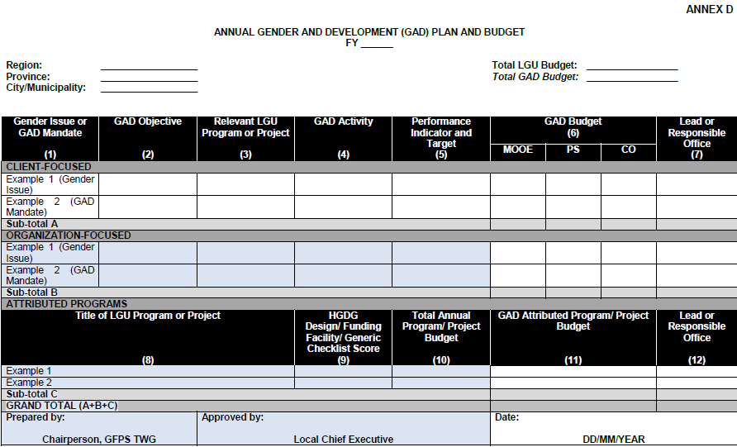
GAD PLAN AND BUDGET FORM PROVINCE/ MUNICIPALITY/ CITY

Slide 64
Guide in Completing the GPB Form

Slide 65
Gender Issue or GAD Mandate (1) | GAD Objective (2) | Relevant LGU Program or Project (3) | GAD Activity (4)
Organization Focused
Slow progress of gender mainstreaming in the LGU. | To facilitate and sustain gender mainstreaming in the LGU and, thus, address the gap of the LGU in integrating gender dimension it its programs and/or services. | Gender and Development | Issue an executive order for the creation and/or strengthening of the GFPS or similar mechanism Create and/or strengthen the GFPS of the LGU

Slide 66
Performance Indicator or Target (5) | GAD Budget (6) |  |  | Lead or Responsible Office (7)
 | MOOE | PS | CO
8 capacity building activities for the GFPS members conducted by the end of the year (planning and budgeting, gender analysis, gender assessment, GAD tools) | Php 2,000,000.00 Honorarium for Subject Matter Experts = Php XXX,000.00 Food = Php XXX,000.00 Briefing Materials = Php XXX,000.00 Zoom subscription = Php XXX,000.00 | SG 24 Php 86,742.00/22 =3,942.82/8 =492.84x3(in a day) =Php 1,309.80 x 4 days =Php 5,239.23 x 8 = Php 41,913.84 SG 26 Php 111,742.00/22 =5,079.18/8 =634.90x3(in a day) =Php 1,904.70 x 4 days =Php 7,618.80 x 8 = Php 60,950.4 |  | Human Resources Division

Slide 67

Schedule to be observed in Local
GAD Planning and Budgeting

Slide 68
Month | Actions
January (a year before the budget year) | The LCE shall issue a directive (i.e., memo or executive order) to all its departments/offices for the preparation of their annual GPB and annual GAD AR All LGU departments/offices, including barangays, shall formulate their GAD AR of the preceding year
February | GPBs of the barangays shall be submitted to the GFPS of the city/municipality for review as stated in Section 5.1.9.11 under the General Functions of the GFPS. In accordance with COA Circular 2014-001, all LGUs, including barangays, are required to submit their GAD AR of the preceding year on or before the 5th working day of February to their respective city/municipality, copy furnished to the COA Audit team. Likewise, provinces, cities, and municipalities shall furnish a copy of their respective GAD ARs to their respective DILG ROs or Provincial LGUs, as the case may be.

Slide 69
Month | Actions
March | GPBs of component cities and municipalities shall be submitted to the GFPS of the province for review as stated in Section 5.1.10.1.4 under the Roles and Responsibilities of the LGU GFPS.
April | GPBs of all provinces, HUCs, ICCs, and LGUs in Metro Manila shall be submitted to DILG ROs for review as stipulated in Section 5.3.6.1 under Submission, Review and Endorsement of LGU GAD Plans and Budgets.
April - May | DILG ROs shall review and endorse province/HUC/ICC GPBs, which shall be returned to the concerned LGU for inclusion in the preparation of the AIP, not later than the end of May. On the other hand, the LCE of the province through its GFPS shall review and endorse GPBs with accompanying GAD ARs of cities and municipalities within their jurisdiction; the LCE of cities and municipalities through its GFPS shall review and endorse the GPBs with accompanying GAD ARs of barangays within their jurisdiction. The review of the LGUs GPB will cover the alignment of the LGUs plan to the plan of the higher LGUs and the gender responsiveness of the PPAs of the GPB.

Slide 70
Month | Actions
June | Issuance of the Budget Call by the LCE to all LGU departments/offices.
July-August | Integration of the endorsed GPB PPAs in the annual budget proposals of concerned LGU departments/offices. The Local Finance Committee (LFC) shall ensure the integration of the GPB in the LGU budget proposals during the technical budget hearings.
September | The LFC shall ensure that the identified GAD PPAs are reflected in the Local Expenditure Program and the Budget Expenditure and Sources of Financing.
October | Pursuant to Section 318 of RA No. 7160, the LCE shall ensure that the identified GAD PPAs are included in the Budget Message and in the Executive Budget for submission to the Local Sanggunian for its enactment not later than the 16th day of October of the current fiscal year.

Slide 71

Submission, Review, and Endorsement
of LGU GAD Plans and Budgets and GAD Accomplishment Report

Slide 72

Submission of LGU GAD Plans and Budgets
All provinces, HUCs, ICCs, and LGUs within Metro Manila shall submit their GPBs, accompanied by their GAD ARs, to the DILG RO via DILG’s GAD Portal (Gender and Development Plan and Budget Monitoring System (GADPBMS), for their review and endorsement

Slide 73

Submission of LGU GAD Plans and Budgets
Component cities and municipalities shall submit their GPBs together with their GAD ARs to the provincial GFPS for alignment of the municipal/city GAD PPAs with the priorities of the province, review on its gender responsiveness and endorsement for incorporation in their annual budgets to be enacted by their Local Sanggunian.
PROVINCIAL GFPS

Slide 74

Submission of LGU GAD Plans and Budgets
Barangays shall prepare and submit their GPBs to their respective city/municipal-level GFPS to ensure the alignment of the barangay GAD PPAs with the priorities of the city/municipality and to review the PPA for gender responsiveness. The city/ municipal-level GFPS shall endorse the GPB if these criteria are met. Reviewed and endorsed GPBs shall be returned to the concerned barangays for incorporation in their AIPs and annual budgets.
CITY / MUNICIPAL GFPS
The endorsed GPBs shall include a Certificate of Endorsement from the reviewing office.

Slide 75

Submission of LGU GAD Plans and Budgets
Submission, review, revision, and endorsement of the LGU GPB shall be conducted from February to April. To reiterate the aforementioned provisions, the following offices shall review and endorse the integration of the GPB to the annual budget and AIP to wit:
City/municipal GFPS for barangays;
Provincial GFPS for component cities/municipalities; and
DILG ROs for provinces, HUCs, ICCs, and all LGUs within NCR.

Slide 76
Submission of LGU GAD Accomplishment Report
The GFPS shall prepare their annual GAD AR based on the endorsed and/or reviewed GPB or enacted LGU budget
The annual GAD AR shall be accompanied by the following:
(1) a brief summary of the reported program or project;
(2) copies of reported policy issuances;
(3) results of HGDG assessment; and
(4) actions taken by the LGU on the COA audit findings and recommendations.

Slide 77
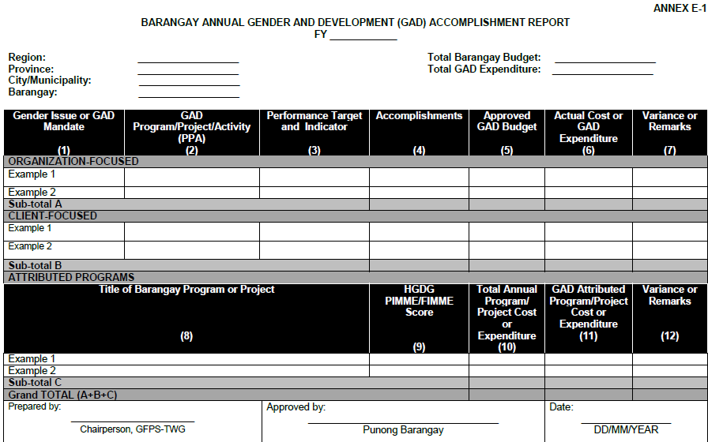
GAD ACCOMPLISHMENT REPORT FORM BARANGAY LEVEL

Slide 78
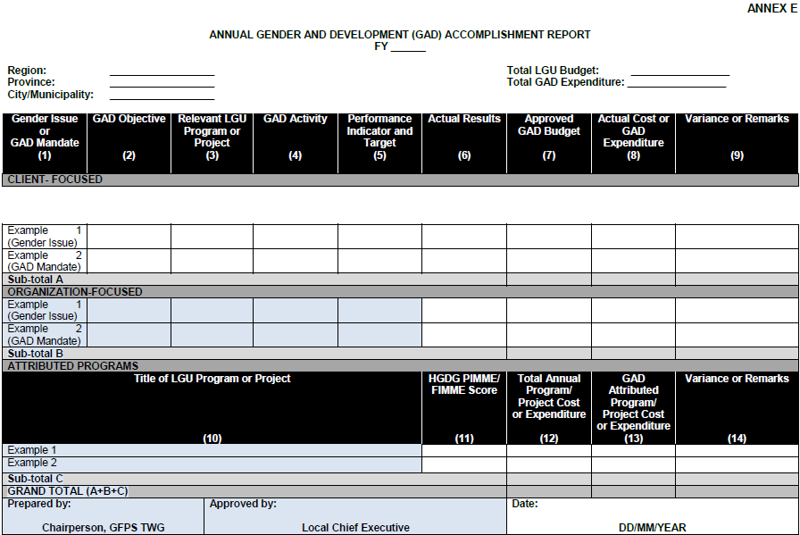
GAD ACCOMPLISHMENT REPORT FORM PROVINCE/MUNICIPALITY/CITY

Slide 79
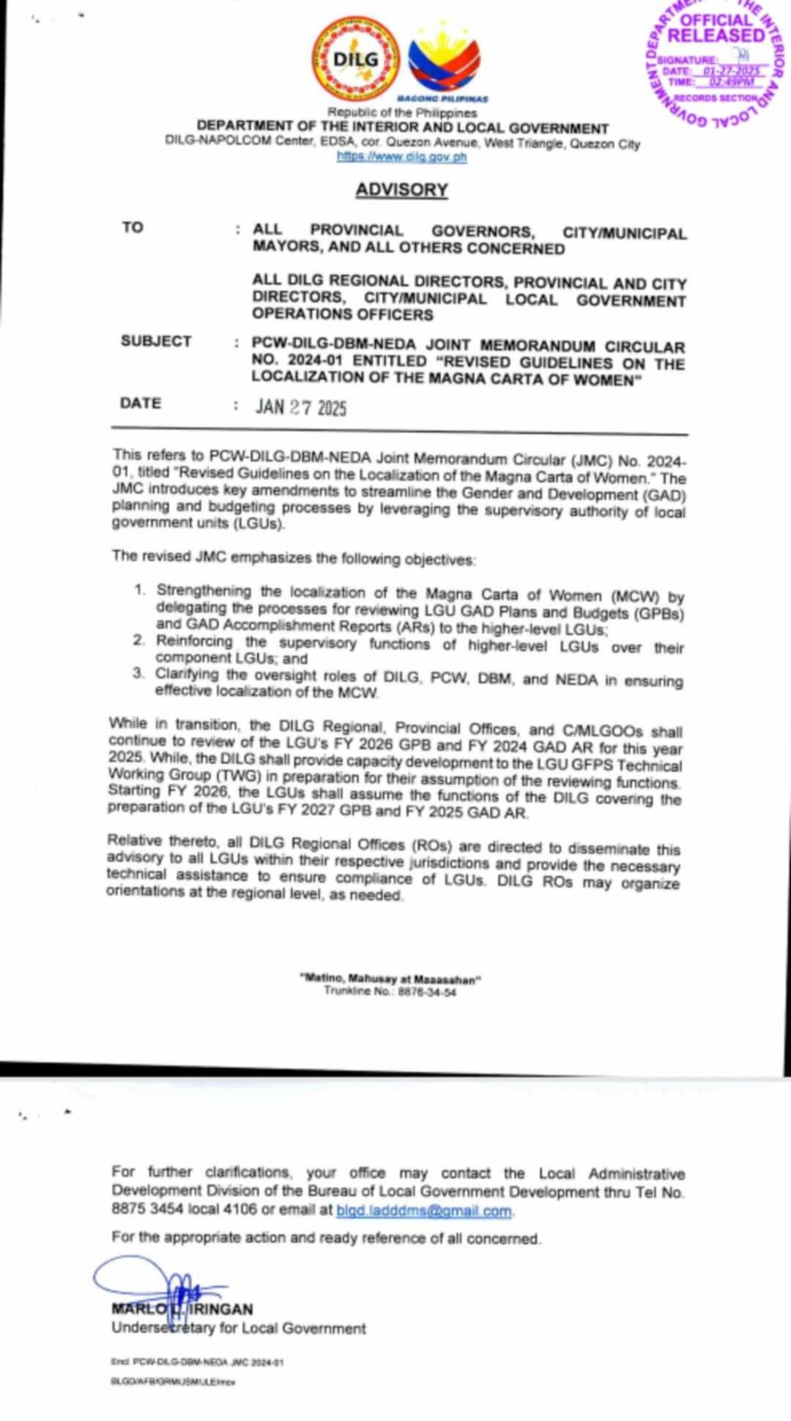

Slide 80
Mainstreaming Gender Perspectives in Local Development Plans

Slide 81

Mainstreaming Gender Perspectives in
Local Development Plans
The following activities shall be undertaken to ensure effective GAD Mainstreaming in LDPs:
Revisit LGUs vision, sectoral plans and investment programs and assess according to gender responsiveness;
Gather, collate and analyze the LGUs situation through the use of gender analysis and/or GAD tools; use of GAD database;
Monitor and evaluate gender-responsive programs and projects; and
Reflect the GAD PPAs as indicated in the LGU GPB in the AIP.

Slide 82
LGU GAD Code

Slide 83
LGU GAD Code
All LGUs shall formulate and pass their GAD Codes or ordinances to support the LGU’s efforts in promoting, protecting and fulfilling women’s human rights, women’s economic empowerment and gender-responsive governance towards the attainment of gender equality and women’s empowerment.
The LGU GFPS shall assist the Local Sanggunian in the formulation of a GAD Code or ordinance.
Funding requirements in the formulation and implementation of the Code shall be charged to the LGU GAD budget.
LGUs shall ensure that the pertinent provisions of the GAD Code are integrated in local development plans.

Slide 84
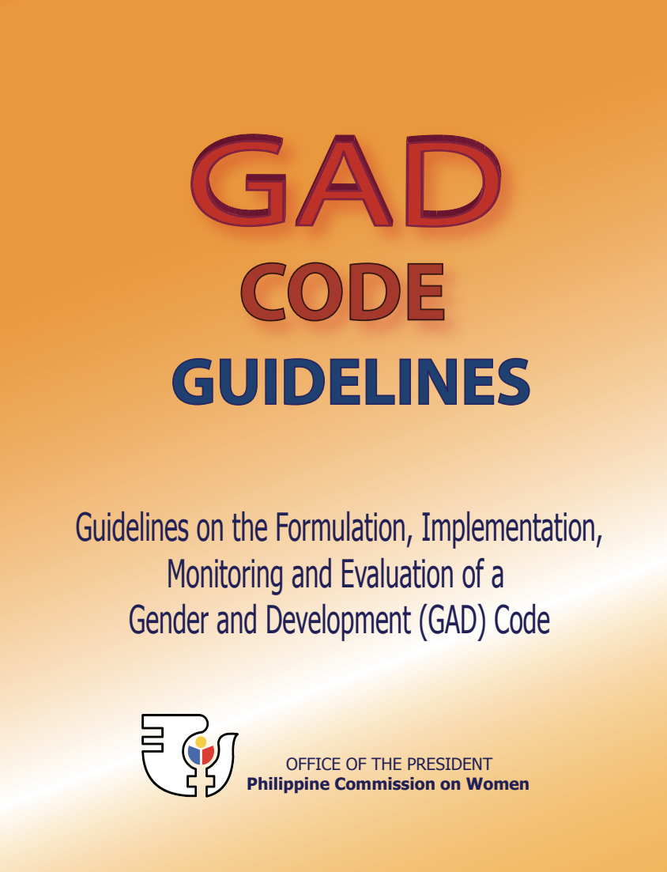
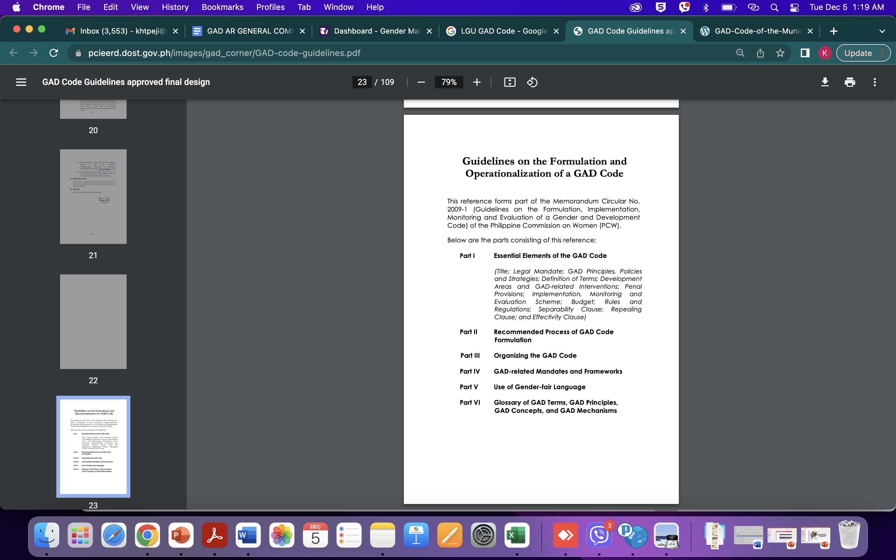

Slide 85
MONITORING AND EVALUATING THE
IMPLEMENTATION OF MCW

Slide 86




5
Institutional Mechanisms
Monitoring and Evaluating the Implementation
of Magna Carta of Women
Evaluation
Evaluate the GAD mainstreaming efforts which will include the outcomes of gender-responsive PPAs during the 3-year term of the LGU leadership
Annual Report
Prepare the report and submit the same to the DILG Regional Office
Annual GPB
Monitor the implementation
M & E Team
The LCE shall issue an EO creating the M&E Team

Slide 87

GAD Funds Audit
Role of the DILG
Pursuant to MCW Section 36 and this JMC, the Commission on Audit (COA) shall conduct an annual audit of GAD funds for the purpose of determining the judicious use of the GAD budget and the efficiency and effectiveness of interventions in addressing gender issues towards the realization of the objectives of the country’s commitments, plans, and policies on GAD, gender equality and women’s empowerment.
Provided further in MCW-IRR Section 37, the COA shall conduct an annual audit of GAD funds of all government agencies, offices, bureaus, SUCs, GOCCs, LGUs, all government instrumentalities and all others concerned.

Slide 88
Expenses that can be charged to the GAD Budget
Programs, projects, activities (PPAs) included in the DILG-approved LGU GAD plan, including relevant expenses such as supplies, travel, food, board and lodging, professional fees, among others;
Capacity development on GAD (e.g. Gender Sensitivity Training; Gender Analysis, Gender-responsive Planning and Budgeting, among others.);
Activities related to the establishment and/strengthening of enabling mechanisms that support the GAD efforts of LGUs (e.g. GAD Focal Point System, VAW desks, among others);
Salaries of LGU personnel assigned to plan, implement and monitor GAD PPAs on a full-time basis, following government rules in hiring and creating positions;
Time spent by LGU GAD Focal Point System members or LGU employees doing GAD related work. Overtime work rendered in doing GAD related PPAs may be compensated through a compensatory time off (CTO), following government accounting and auditing rules and regulations;

Slide 89
Expenses that can be charged to the GAD Budget
Salaries of police women and men assigned to women’s desks;
Salaries of personnel hired to manage/operate the GAD Office, if established;
LGU programs that address women’s practical and strategic needs (e.g. day care center, breastfeeding rooms, crisis or counseling rooms for abused women and children, halfway houses for trafficked women and children, gender-responsive family planning program, among others);
Construction expenses for the following : a) Day care center; b) VAWC Center; c) Halfway Houses for trafficked women and girls; and d) Women crisis center
Consultations conducted by LGUs to gather inputs for and/or to disseminate the GAD plan and budget;
Payment of professional fees, honoraria and other services for gender experts or gender specialists engaged by LGUs for GAD-related trainings and activities; and
IEC activities (development, printing and dissemination) that support the GAD PPAs and objectives of the LGUs.

Slide 90
Expenses that cannot be charged to the GAD Budget
Programs, projects, activities (PPAs) that are not in the LGU’s DILG–approved GAD plan;
Personal services of women employees unless they are working full time or part time on GAD PPAs;
Honoraria for LGU’s GFPS members or other employees working on their LGU GAD programs;
Salaries of casual or emergency employees UNLESS they are hired to assist in GAD-related PPAs;
Provision of contingency funds or “other services” of PPAs; and
Purchase of supplies, materials, equipment and vehicles for the general use of the LGU.
The following expenses CAN NOT be charged to the GAD budget UNLESS they are justified as clearly addressing a specific gender issue:
  Physical, mental and health fitness including purchase of supplies, materials, equipment and information dissemination materials;
  Social, rest and recreation activities; and
  Religious activities and implementation of cultural projects;

Slide 91
Frequently Asked Questions

Slide 92
How does the LGU derive its 5% GAD budget allocation?
As provided for in the General Appropriations Act, the minimum 5% GAD budget shall be derived from the total budgetary appropriations which are drawn from the PS, MOOE and CO of the LGU.

Slide 93
Do you provide samples of GAD Activities that can be included in the GAD Plan?
It is advised to conduct Gender Analysis first to determine its priority gender issues. Once gender issues have been identified as a result of gender analysis and review of SDD/gender-related information, the LGU may now identify and propose target activities in response to the gender issues. LGUs may refer to the content of the GEWE Plan, MCW, BPFA, SDG, and other GAD mandates for list of possible gender issues per sector.

Slide 94
What would happen if the LGU allocated less than 5% of its budget to GAD PAPs?
The minimum 5% is computed based on the total appropriations of the LGU for the year. If the GAD budget is less than 5%, it will be returned and not be endorsed.

Slide 95
Are there sanctions for an LGU that will not implement its GAD Plan?
An Audit Observation Memo from the COA shall be issued to the LGU which requires the latter to provide explanation/ justification.
LGUs may also be investigated by the GAD Ombud for non-compliance to the GPB process.

Slide 96
Key Summary:
GAD Planning and Budgeting serves as a strategic tool to advance gender equality and women's empowerment in governance.
Existing laws and policy frameworks at both the national and local levels mandate gender-responsive planning and budgeting.
Institutionalizing the four key elements of GAD Planning and Budgeting is essential to effectively mainstream gender in programs and policies.
The goal is to move beyond mere compliance and ensure that GAD Planning and Budgeting leads to meaningful, sustainable, and transformative change in governance.

Slide 97

RP Evaluation Form
https://tinyurl.com/Feb262025

Slide 98
Maraming salamat!

